Slide 1


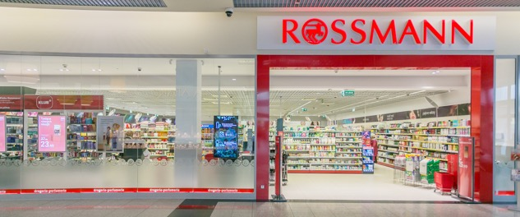
ROSSMANN STORES Sales Forecasting
NADIM SAAD
FEB, 11th | PARIS
DAFT NOV21

Slide 2
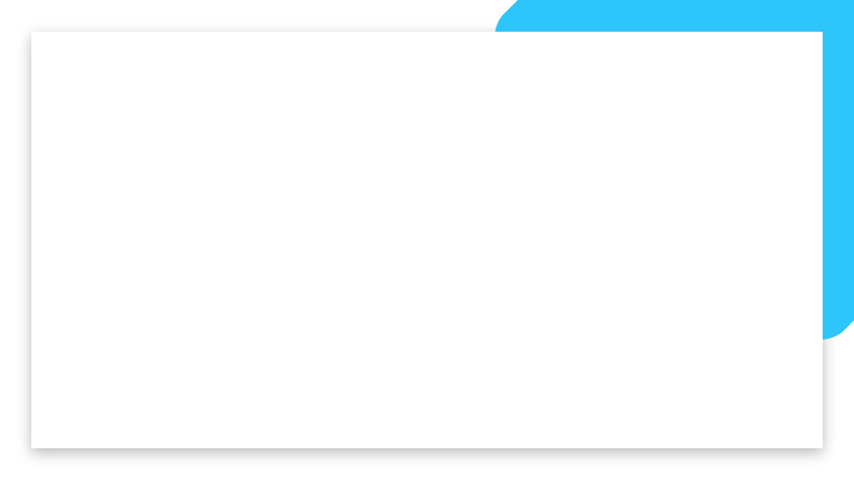
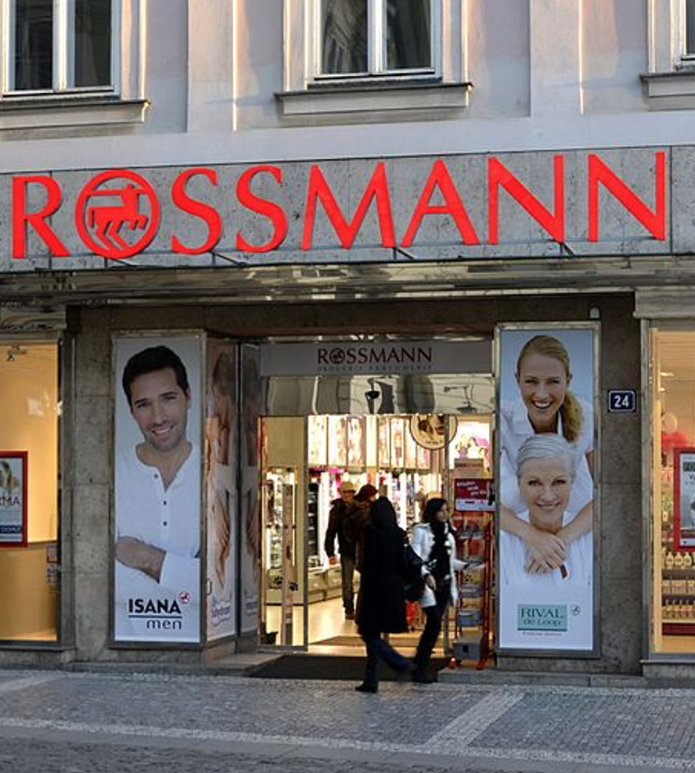

Business case
About the company
Rossmann is the 2nd largest drug store chain in Germany, founded in 1972 by Dirk Rossmann. It operates over 3,000 drug stores in 7 European countries, its HQ is situated in Burgwedel. The drugstore chain employs more than 28,000 people.
Rossmann Stats
Rossmann offers over 17,500 different items in its biggest retail outlets. Besides the pharmaceutical goods, they have pet food, healthy food and a large selection of wines. 800 of their drug stores offer toys and stationery as well.
Problem
Rossmann wishes to predict daily sales and the number of customers instead of relying only on their stores managers intuitions by creating effective sales forecasts based on a machine learning model aiming to minimize prediction errors.
By helping Rossmann create a robust prediction model to deal with objective data, I will be helping store managers stay focused on what’s most important to them: their customers and their teams!

Slide 3
Plan
About Data
Data Mining, Data Preparation, Data Analysis (EDA)
- Data Exploration, Data Wrangling, Data Cleaning, …
- EDA (Exploring the Data and Analysing it)
- Data Correlation
- Data Encoding
Determine which Machine Learning (ML) models to use
Compare my models
Conclusion
Prepare the visualisation on Tableau
I have been provided with 2 datasets:
data_impr.csv
Rows: 1,017,209
Columns: 9
Models
Since we are dealing here with a Sales Forecast case, I decided to implement the following ML models:
- Linear Regression
- Lasso Regression
- Decision Tree Regressor
- Prophet Regression
store.csv
Rows: 1,115
Columns: 10

Slide 4
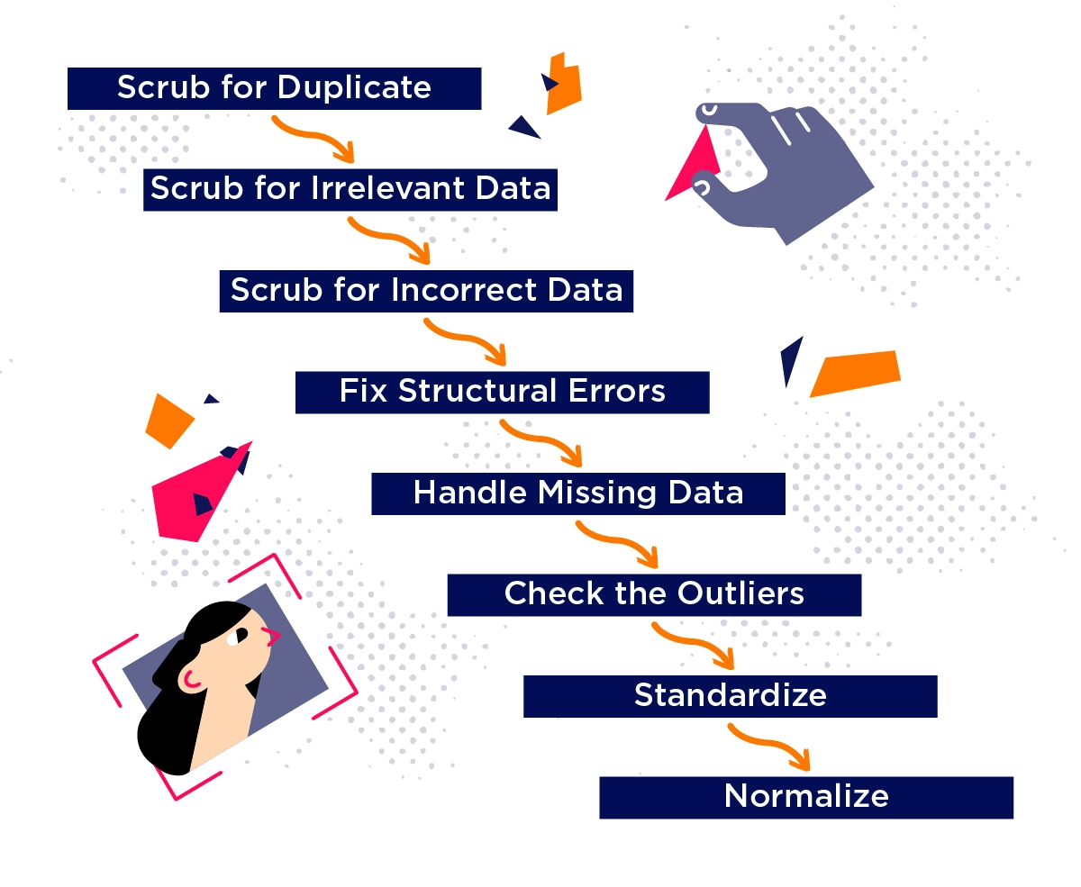
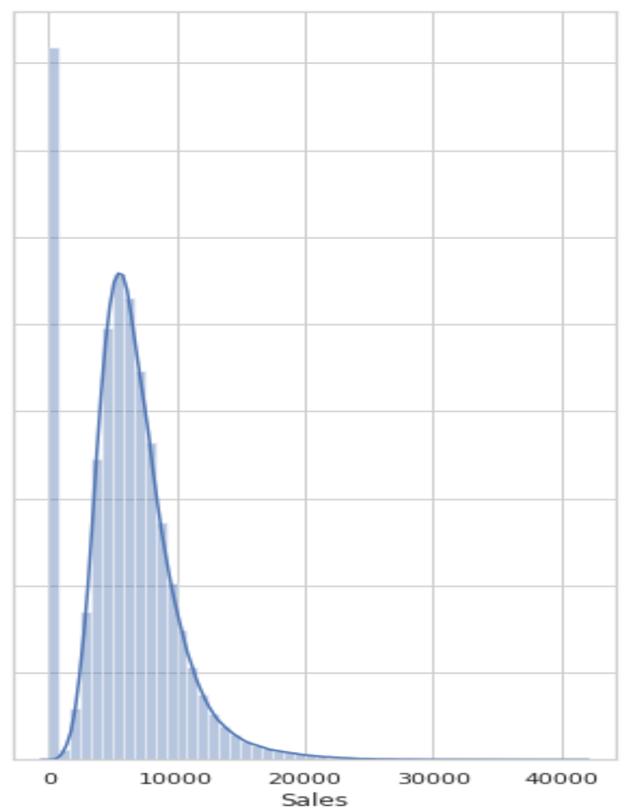
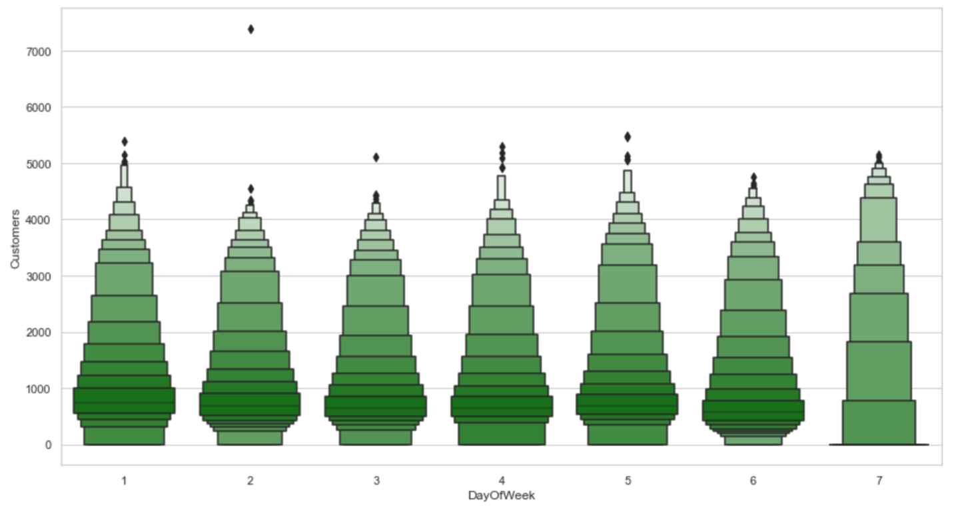
Data cleaning, data preparation
First, I merged the 2 datasets (on store ‘Id’) and then:
- Scrubbed for Duplicates looking for Irrelevant Data (i.e.datetime)
- Handle Missing Values (i.e. null values)
- Check for Outliers (i.e. Sales and Customers)
- Convert data types (i.e. date to Year, Month, Week, Day, Season columns)
- Created new columns (i.e. Avg CustomersPerWeek, PromoCountPerWeek)
Outlier Detection using distplot
Outlier Detection using Boxenplot

Slide 5

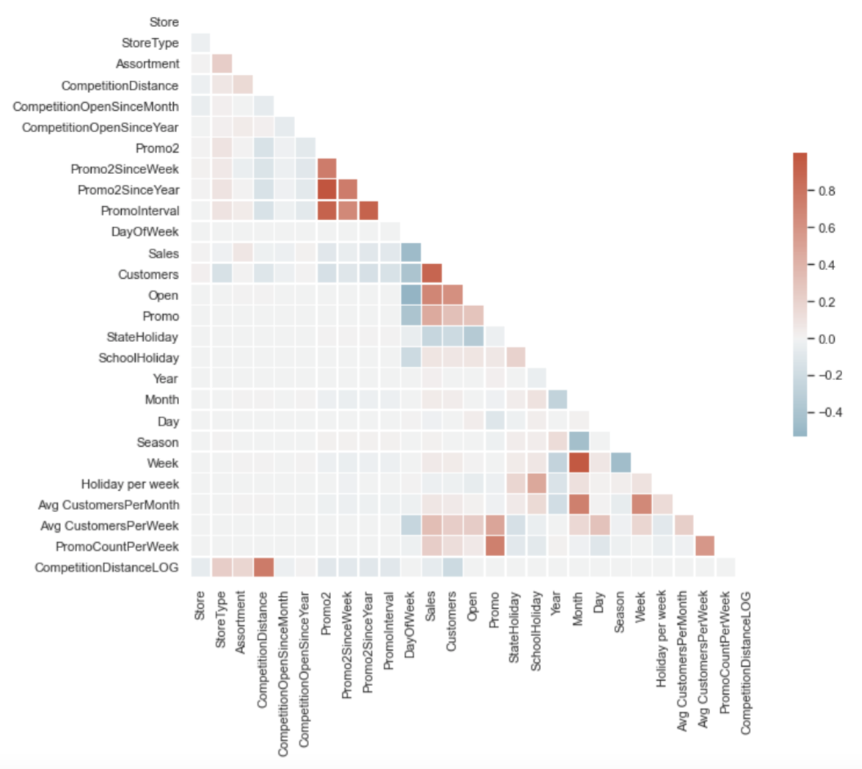
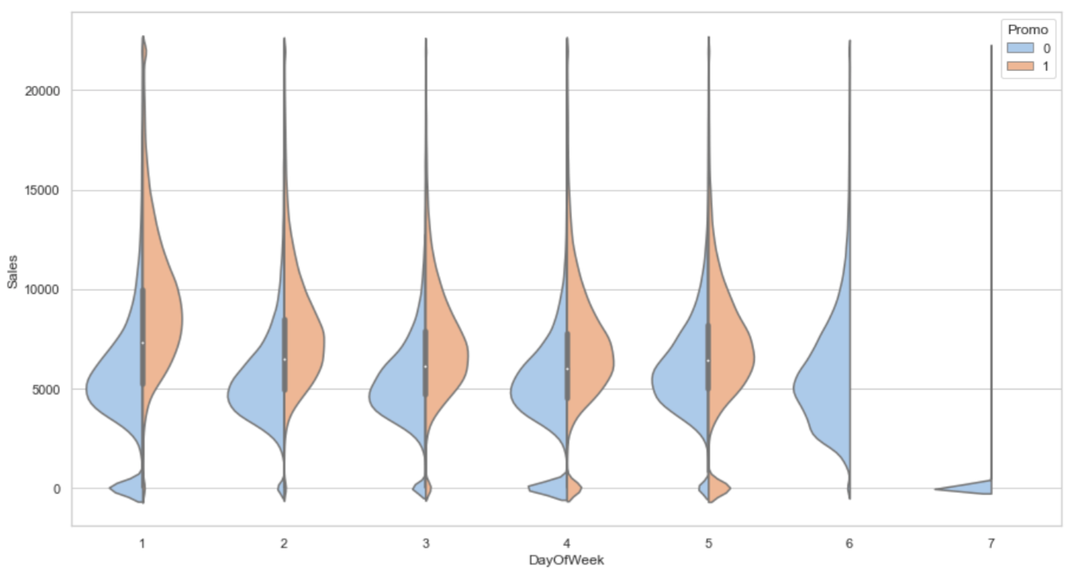
EDA
Correlation
I analysed as per the Business Case prerequisites:
- Finding the locations of the Rossmann Stores (timeanddate.com)
- Analysed the effect of promotions on sales and visiting customers
- Checked the impact of nearby competitors on sales
- Verified the affect on school holidays on sales
This analysis helped me reveal meaningful relationships among my variables
Checking the impact of promotions using Violinplot

Slide 6
Models
For my modelling task, I decide to use 4 different types of models to predict my forecasts:
Model # 1: Linear Regression
LR is Supervised Machine Learning model which finds the best fit linear regression (relationship line) between the independent (X) and dependent (y) variables
Model # 3: Decision Tree Regressor
DTR builds regression models in the form of a tree structure. It breaks down a dataset into small subsets while developing in parallel an associated decision tree. The final result is a tree with decision and leaf nodes.
Model # 2: LASSO* Regression Model
LR is a type of LR model that uses shrinkage (where data values are shrunk towards a central point, like the mean). The lasso is good for simple/ sparse models with fewer parameters
Model # 4: Prophet Regression Model
Prophet is an additive RM with a piecewise linear or logistic growth curve trend. It includes a yearly seasonal component model using series & a weekly seasonal component model using dummy variables
LASSO stands for Least Absolute Shrinkage and Selection Operator
ARIMA stands for Auto Regressive Integrated Moving Average

Slide 7
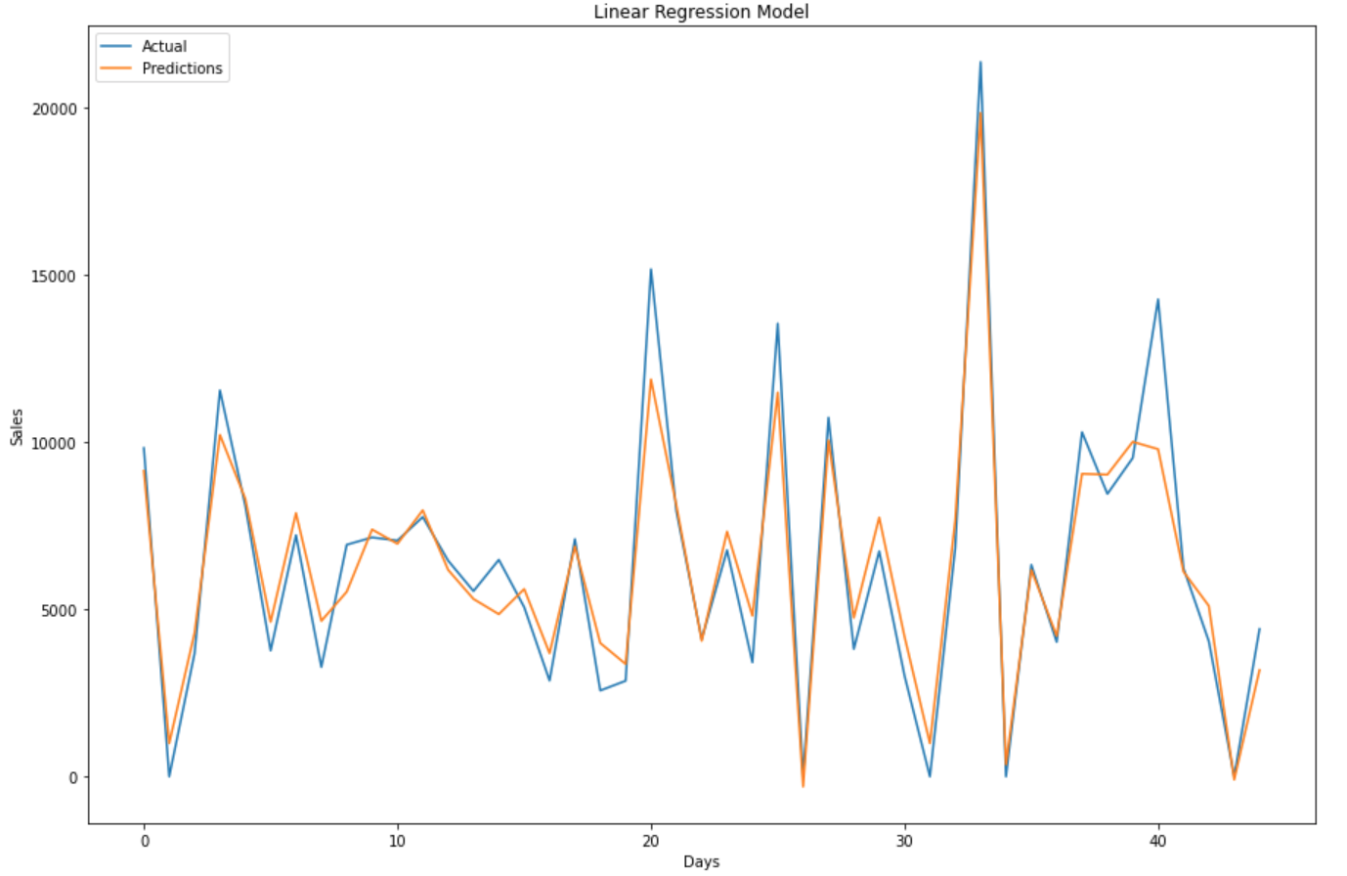
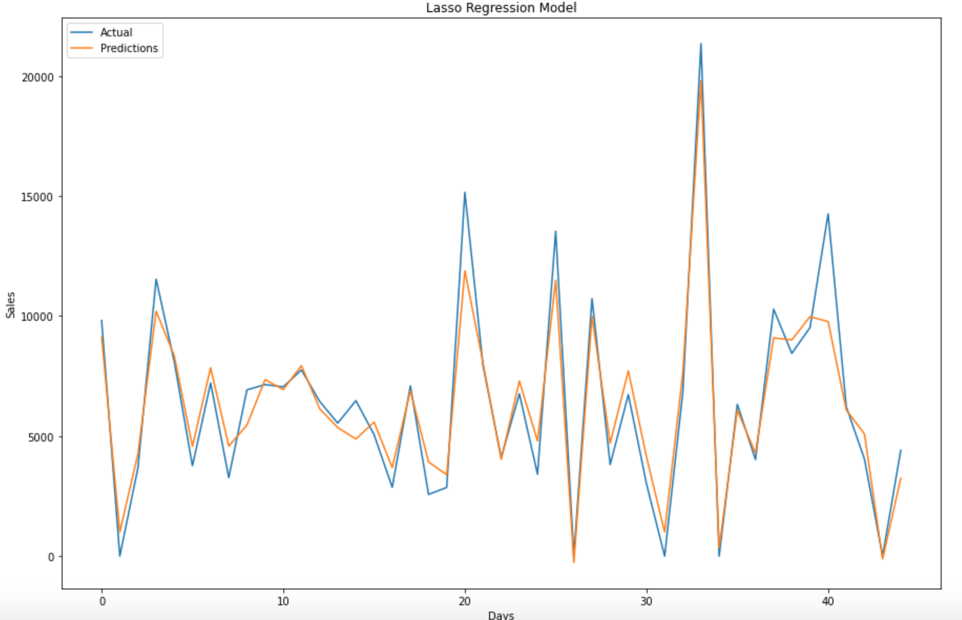
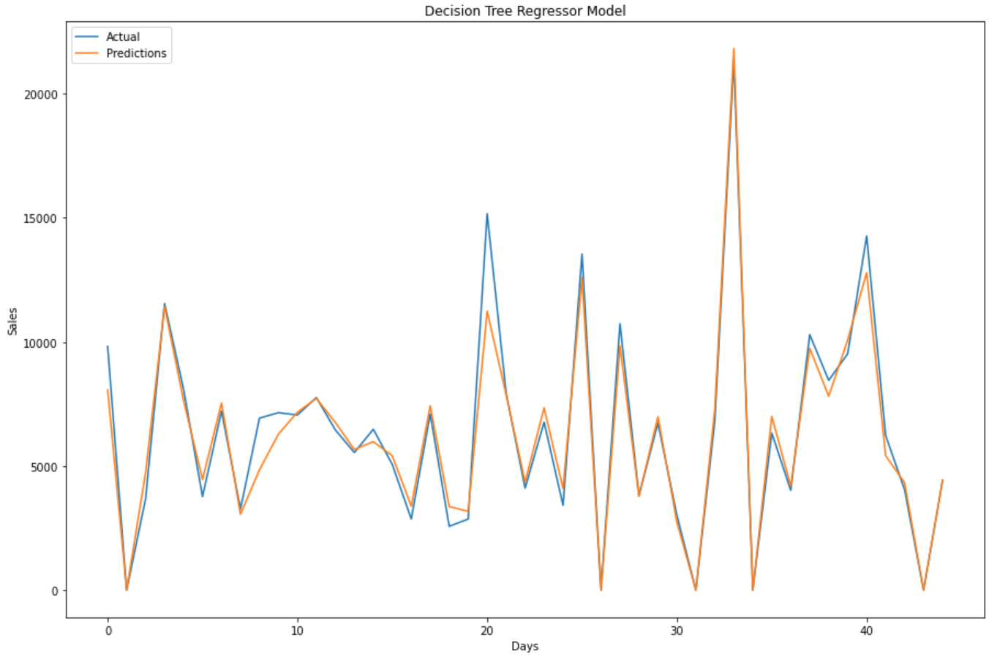
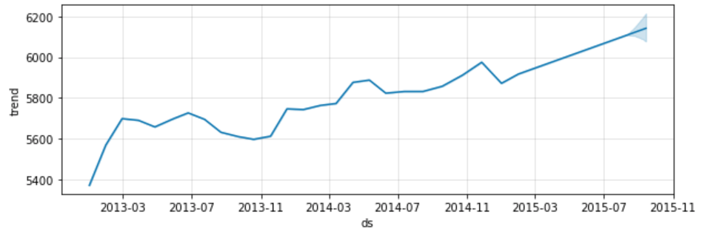
Models evaluation
X_train.shape, y_train.shape, X_test.shape, y_test.shape
(813767, 27) (813767,) (203442, 27) (203442,)
Model # 1: Linear Regression
Model # 2: LASSO Regression
Model Score:
0.874293
Model Score:
0.874151
Model # 3: Decision Tree Regression
Model # 4: Prophet Regression Model
Model Score:
0.951652
Model Score:
0.868187

Slide 8
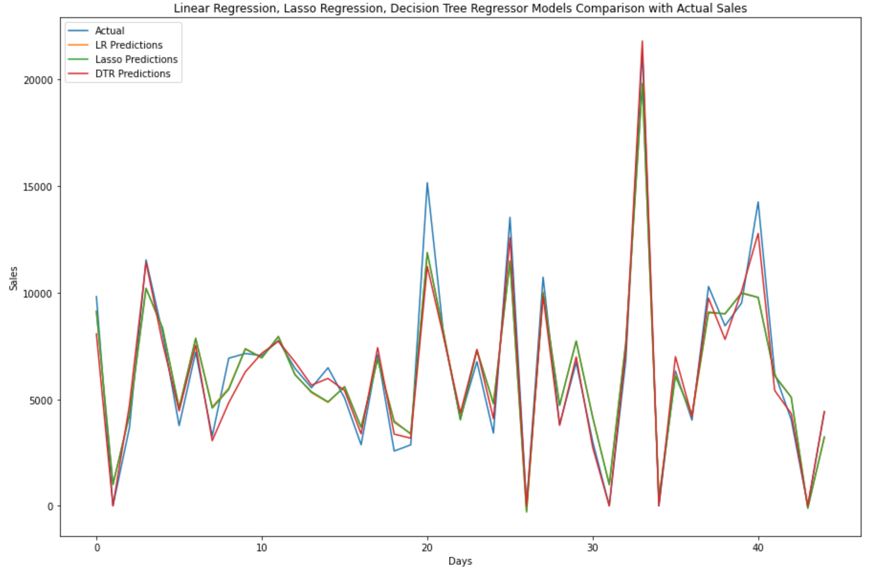
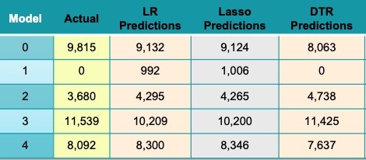
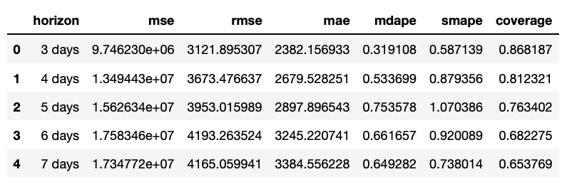
Results
Prophet Model Results

Slide 9
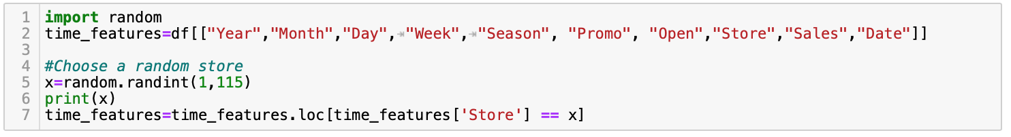
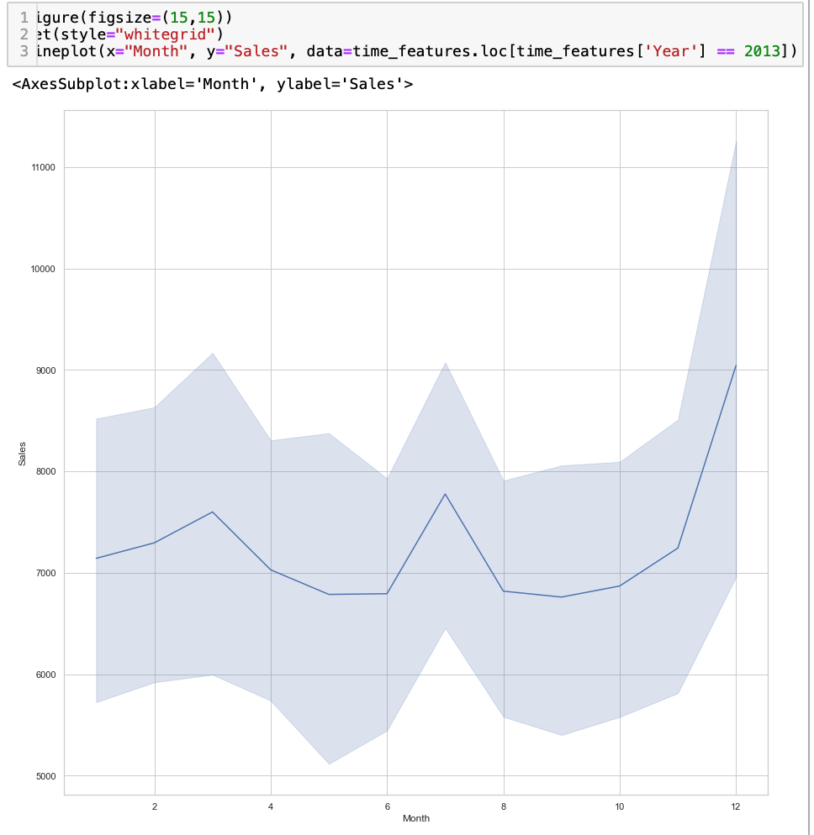
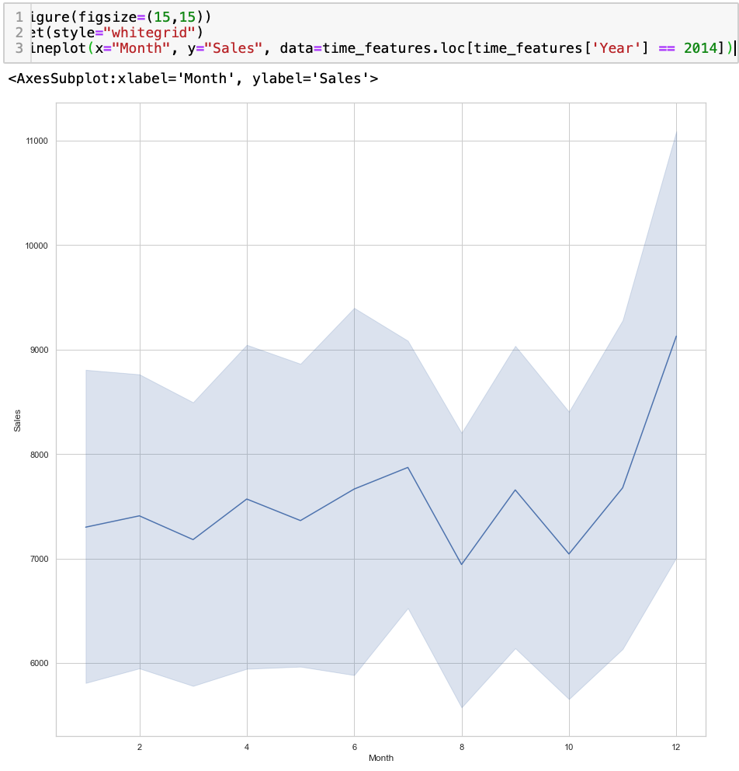
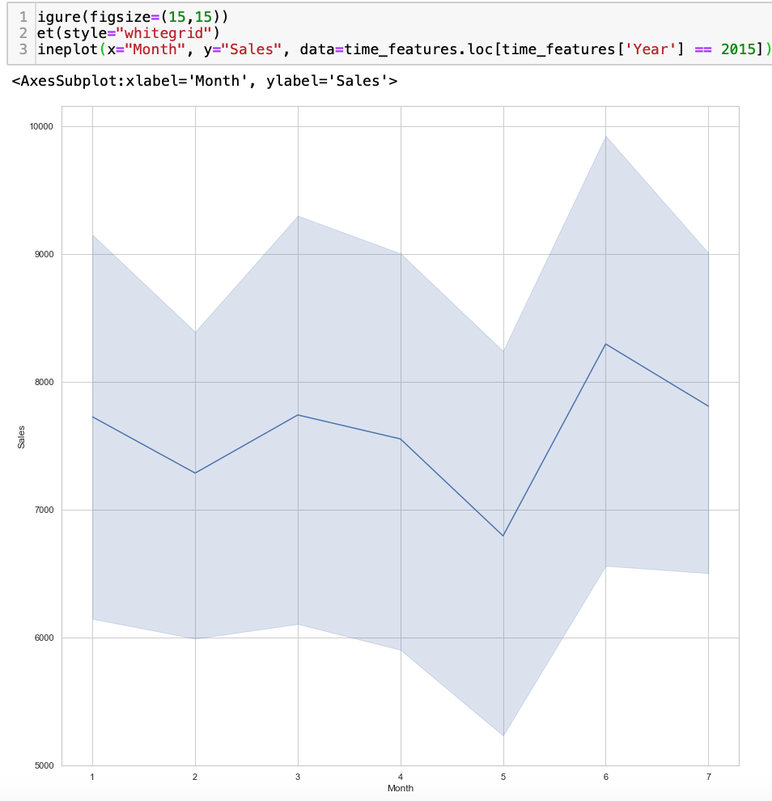
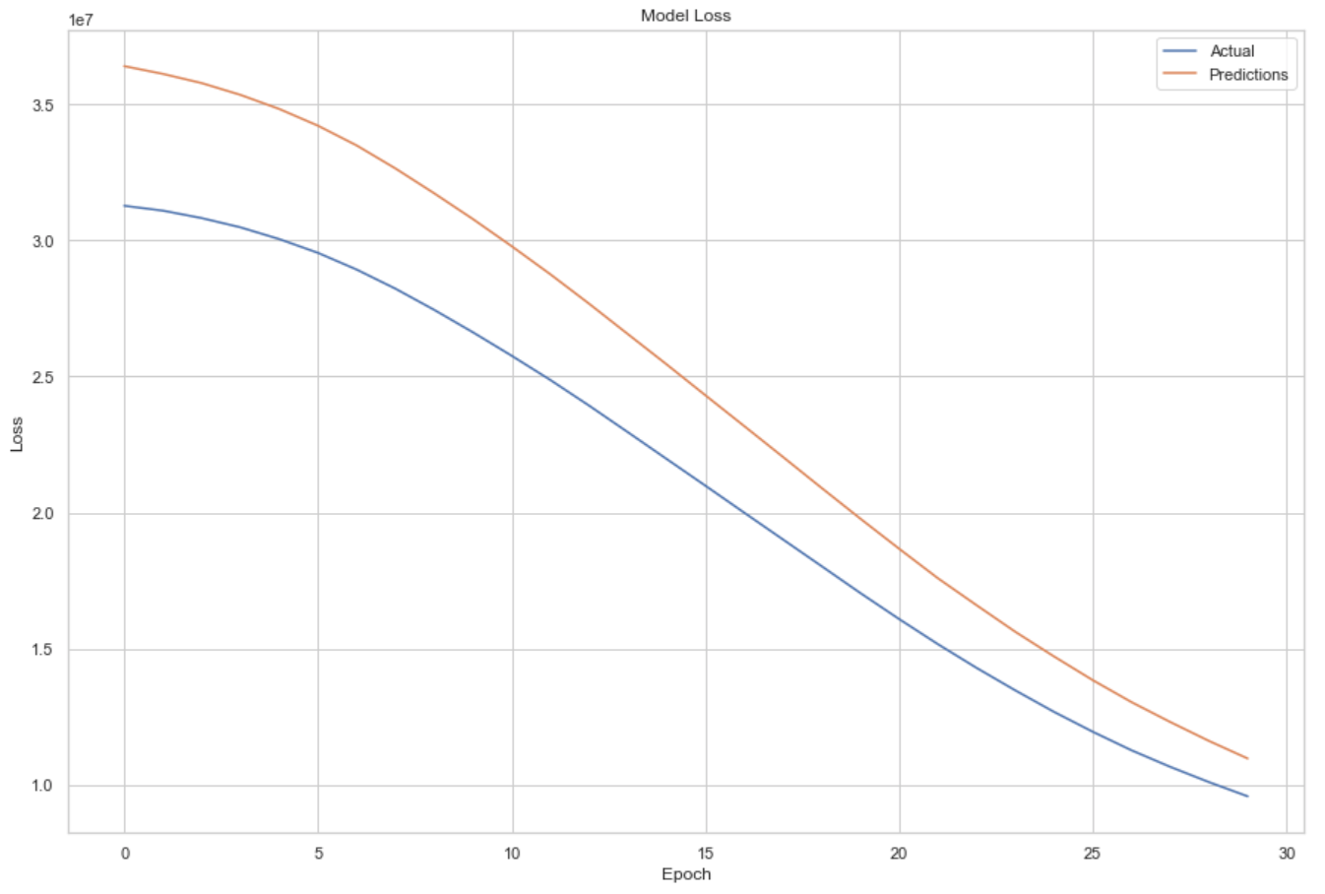
Furthermore
Model # 4: Time Series ARIMA** Model
Most popular/ widely used statistical method for Time Series forecasting. This model makes forecasts based on linear combinations of past variable values and forecasting errors
Time Series Analysis
Loss: A scalar value that we try to minimize during our training of the model. Lower the loss, closer our predictions are to true labels. In Keras, a decrease in loss over n epochs

Slide 10
Conclusion
The Decision Tree Regressor (DTR) model performed best with a score of 95% when comparing it with the other algorithms that I chose.
Hence, I used the DTR model since it is my best suitable algorithm for predicting Rossmann Stores sales forecasts.

Slide 11
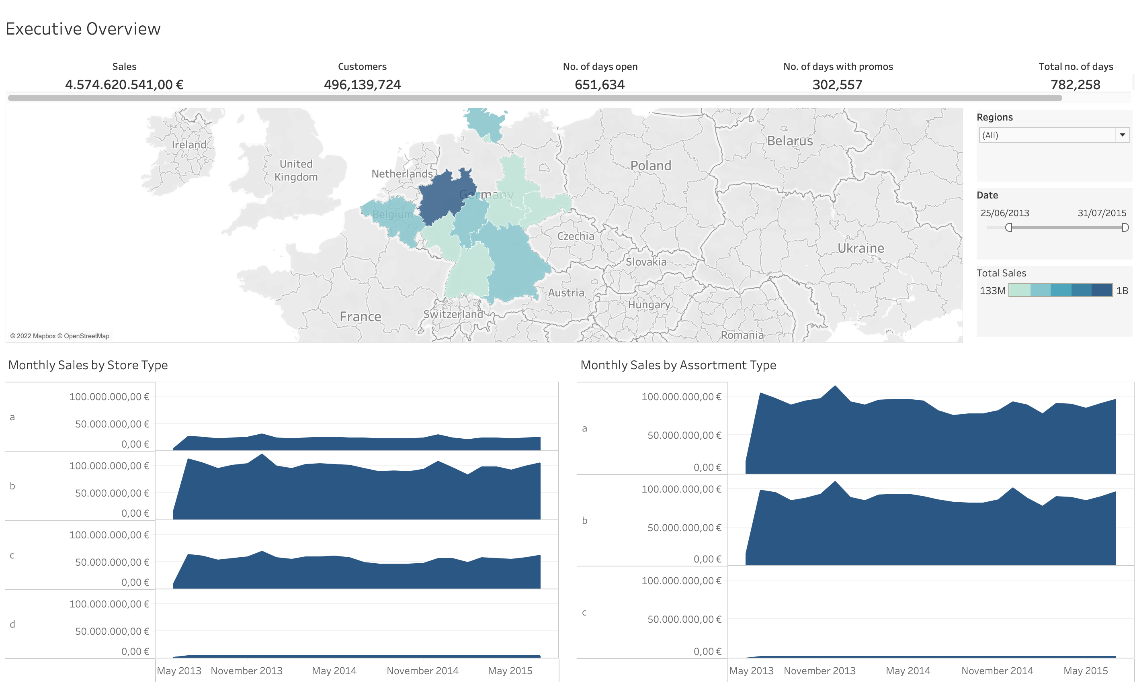
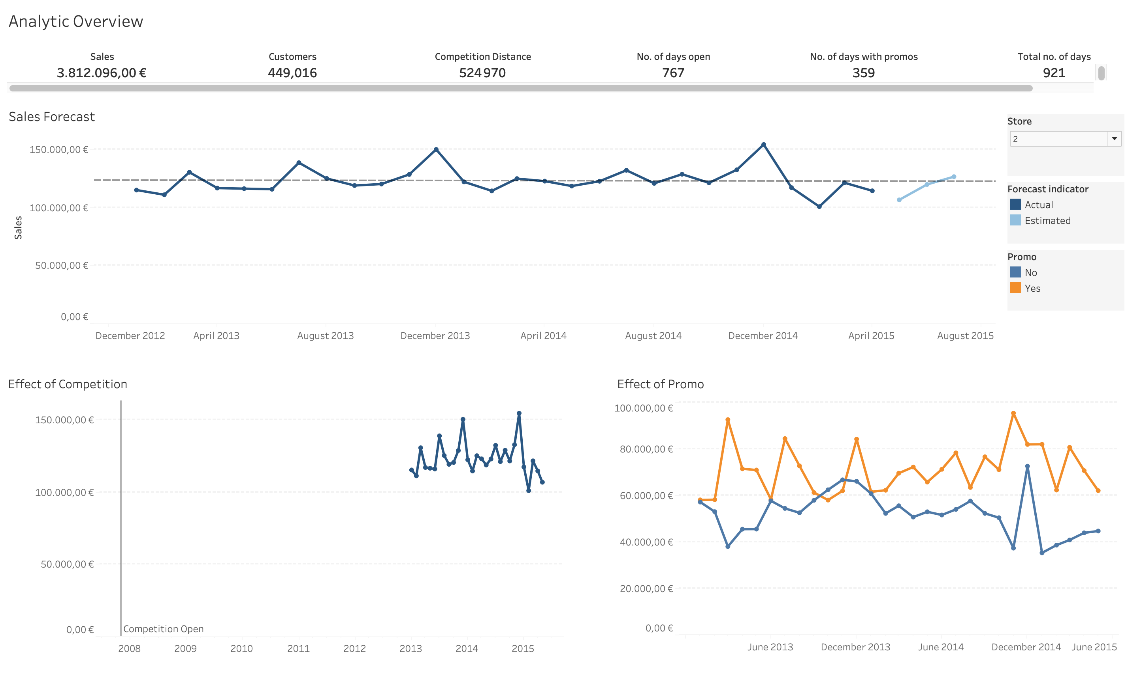
Visualization on Tableau
https://public.tableau.com/shared/K7N79TQ6B?:display_count=n&:origin=viz_share_link
https://public.tableau.com/shared/98BF34FZB?:display_count=n&:origin=viz_share_link

Slide 12

Rossmann Sales
Nadim, Saad
Questions?
THANK YOU.

